Slide 1
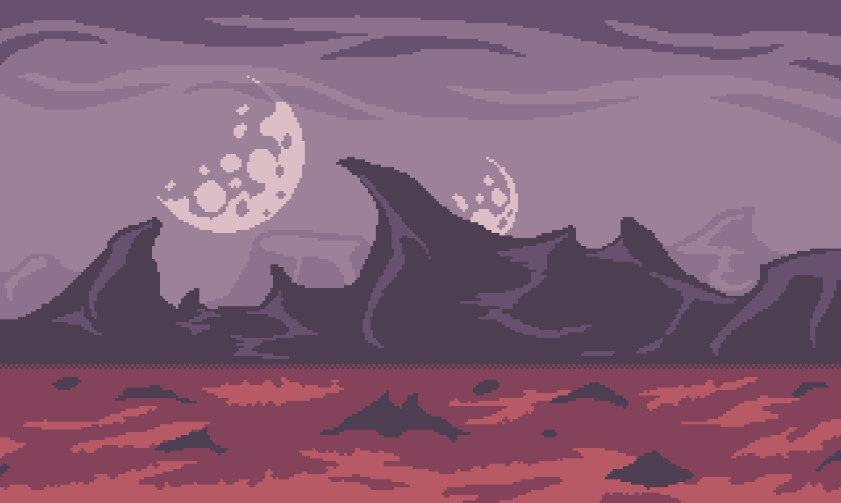
AlterBorne
Skapare:
Malin, Simon, Lydia, David

Slide 2
Malin:
MasterModel
Monster Loop (hemmagjord ful thread)
Loot system
LevelUp system
Shop system
Weapons/Armor/Potions

